Slide 1
Configuring a Drupal 8 Commerce 2 Store on a Shared Web Host
SiteGround Shared Web host
Laptop Product examples
http://cms-freelancers.com/myd8store/web

Slide 2
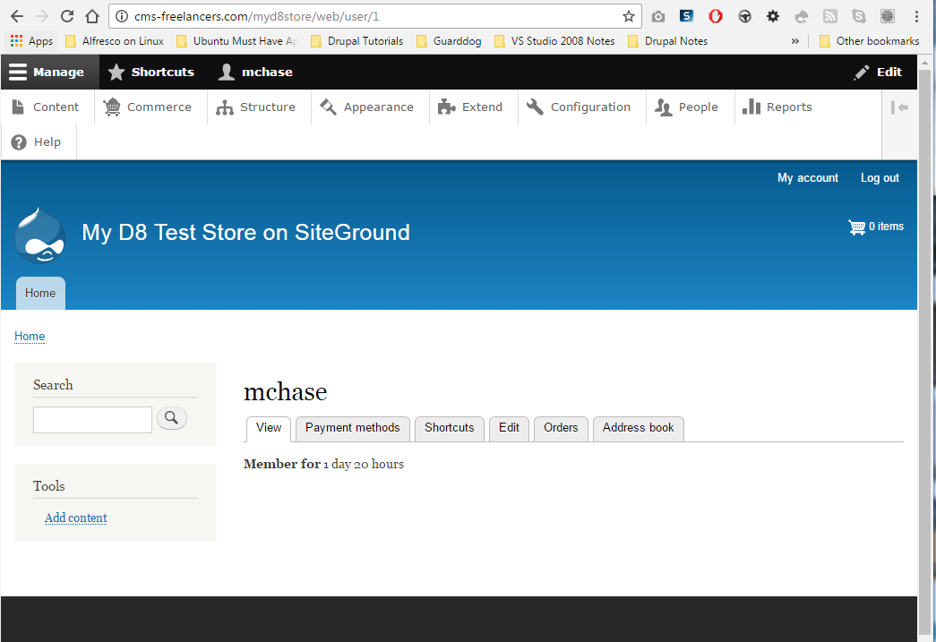
Site Requirements for this presentation
A working Drupal 8 site with commerce installed

Slide 3
Why Drupal Commerce? Why not Magento, Woo Commerce, Zen Cart, or Open Cart?
Drupal provides the best framework
Drupal is FREE (Magento has been called cripple-ware)
https://www.youtube.com/watch?v=e8FLT8k9Yno
Merchants and developers benefits from content and commerce on the same site
Integrated website & commerce
Certified integration with Avalara fro sales tax automation
Drupal commerce lets you scale – Orlo watch website
Need a store in Japan? Spin off a new store and configure it to use Japanese as its primary language
All the orders are store specific

Slide 4
Why Drupal Commerce 2x
Multiple store
Per-store settings
Products belong to one or multiple stores
Orders belong to a single store

Slide 5
Before you start creating a Drupal 8 commerce site
Define your business products:
Define and record all product attributes
Create Product SKU schema (electronic/paper)
Create list of Products, costs, and SKU (electronic/paper)
Determine which countries you will support and your tax responsibility with them
Determine your state tax obligations

Slide 6
Before You Start Working on the D8 Site
Find, install and enable the Admin toolbar and Extend (Modules) page Enhancement Modules:
Admin toolbar: https://www.drupal.org/project/admin_toolbar
Toolbar menu: https://www.drupal.org/project/toolbar_menu
Install the module Filter Module
Module Name: Module Filter
https://www.drupal.org/project/module_filter

Slide 7
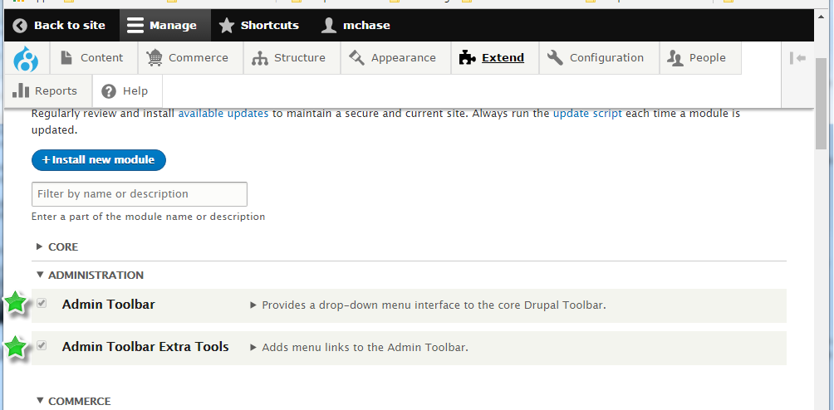
Enable ADMINISTRATION Admin Toolbar and Admin Toolbar Extra Tools

Slide 8
Two ways to get to the page used to configure Views Settings
Admin toolbar > Structure > Views
Select the Settings TAB on the Views List page
Configure the view settings
- OR -
Admin toolbar > Extend (modules page)
Search for Views
Expand the Views UI description section
Select Configure
Select the Settings TAB on the Views List page
Configure the View settings

Slide 9
Our goal is to configure the Views Summary Page, so it’s Advanced View Section is not Hidden
To do this we need to check the check box for “Always show advanced display settings”
And while we are on the Views settings page, we should also enable “Show the SQL query”, so we can see the SQL being generated by Drupal for our View

Slide 10
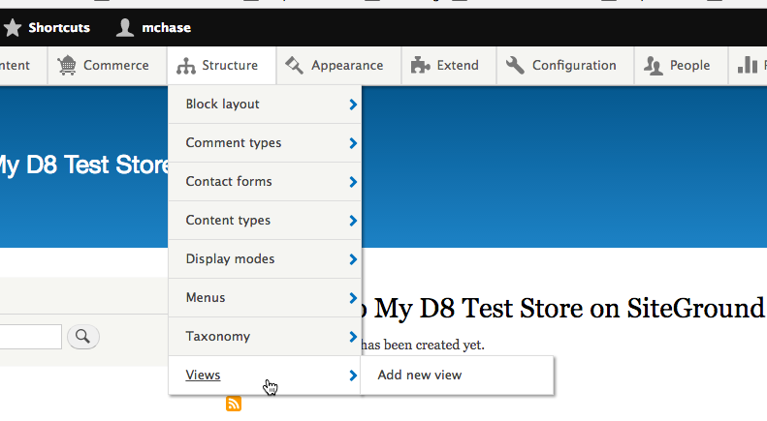
Structure > Views

Slide 11
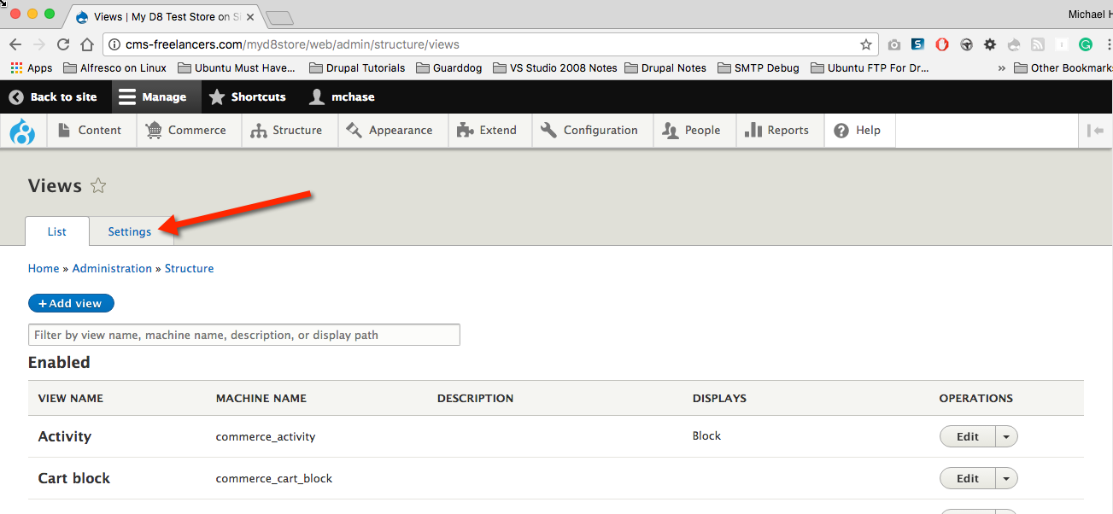
On the Views List Page select the Settings TAB

Slide 12
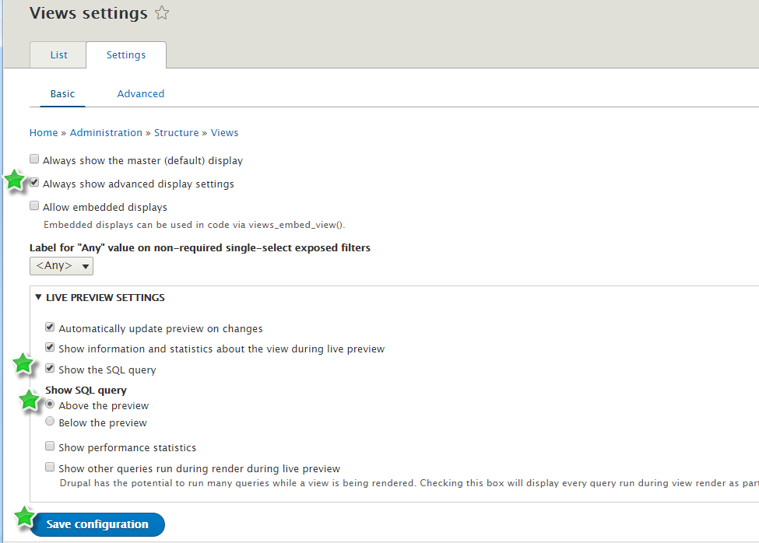
Set Always show Advanced display settings & Show the SQL query & Save

Slide 13
-OR- 2nd way to access the Views Settings page
Admin toolbar > Extend (modules page)
Search for Views
Expand the Views UI description section
Select Configure
Select the Settings TAB on the Views List page
Configure the View settings

Slide 14
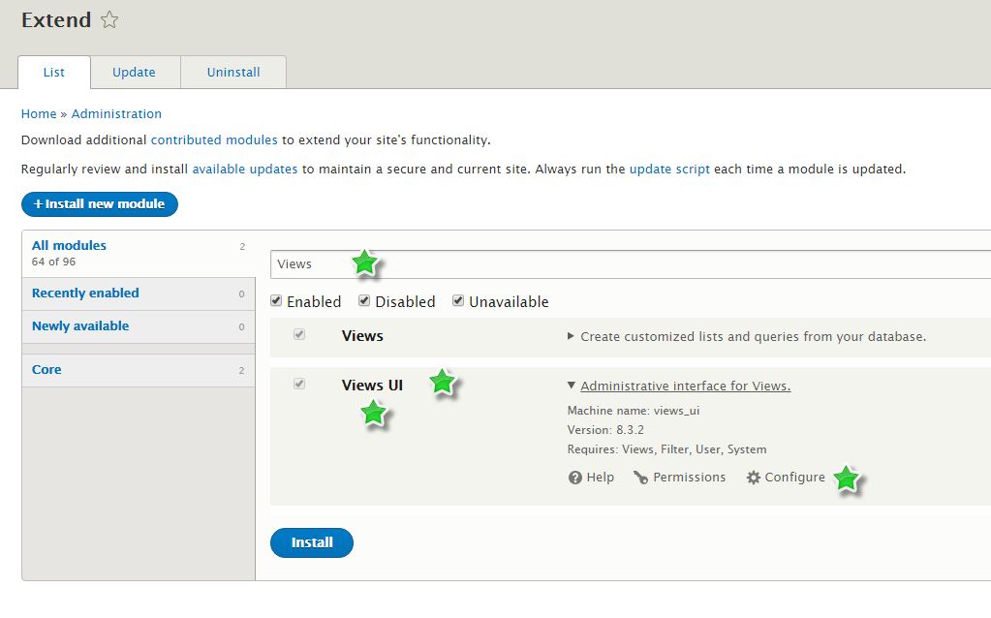
Configure the Views UI Module

Slide 15
On the Views List Page select the Settings TAB

Slide 16
Set Always show Advanced display settings & Show the SQL query & Save

Slide 17
Basic D8 Commerce PART 1 – Import Currency & Create Store
Import Currencies
Commerce > Configurations > Currencies > + Import currency
Select US Dollar
Create a store and configure Tax settings
Commerce > Store
+Add Store

Slide 18
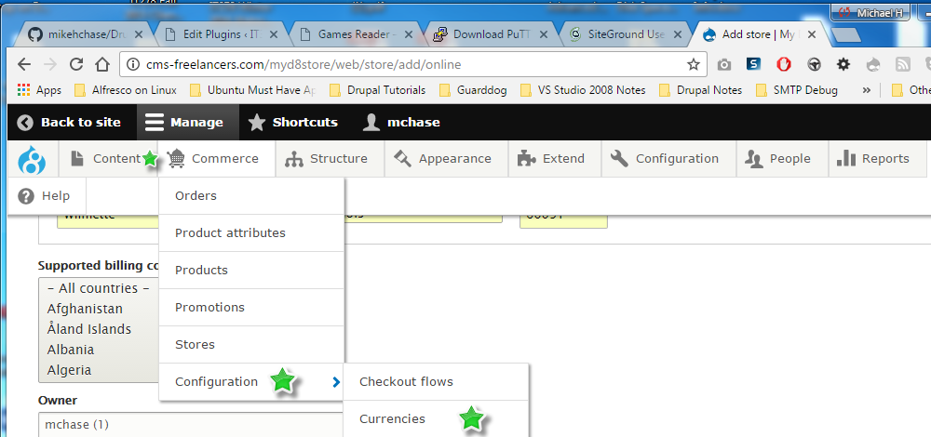
Commerce > Configurations > Currencies

Slide 19
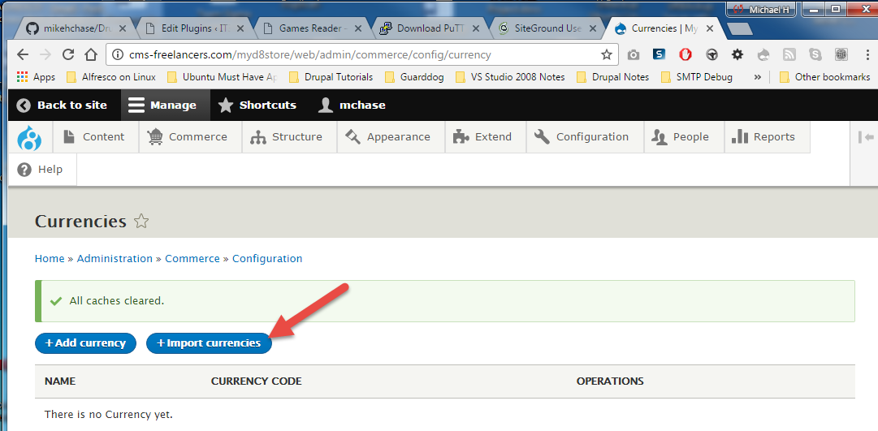
+ Import currencies

Slide 20
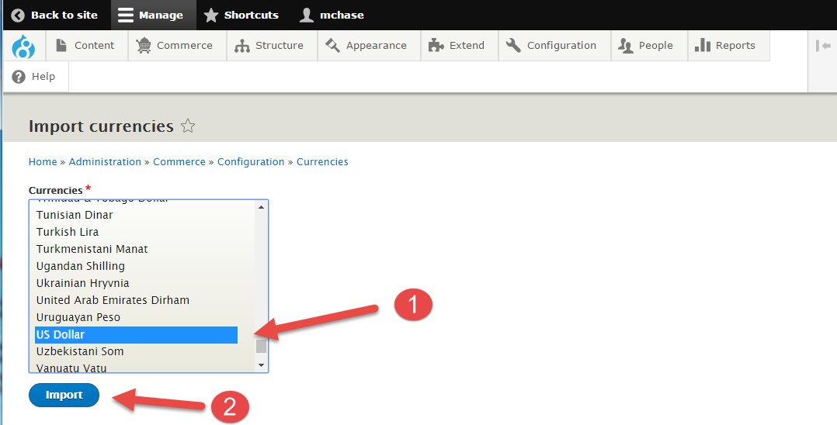
Select US Dollar (or other appropriate currency) and Press Import

Slide 21
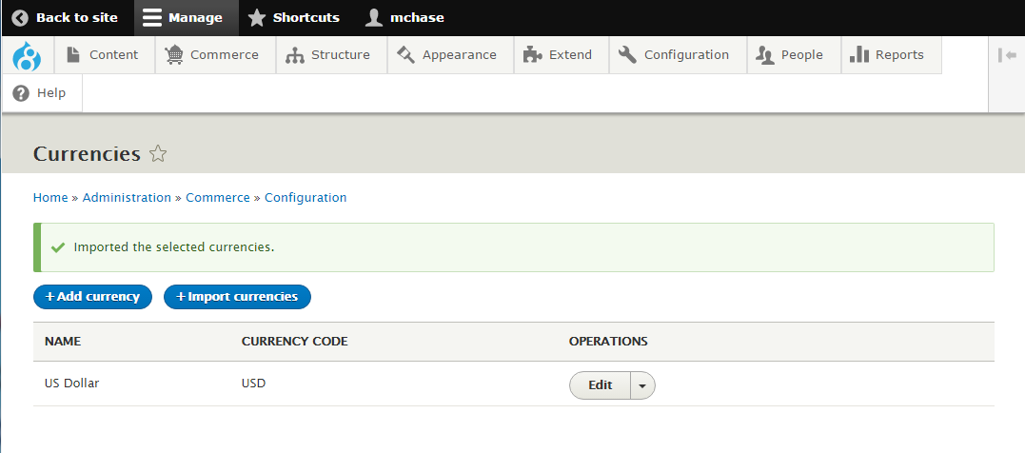
US Dollar Currency Imported

Slide 22
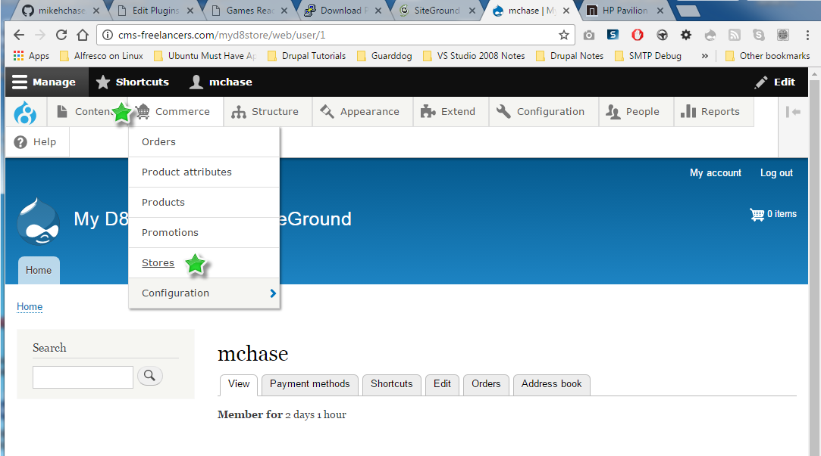
Commerce > Stores

Slide 23
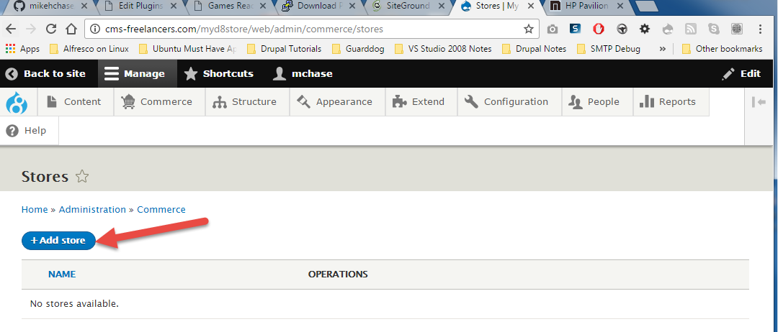
+ Add store

Slide 24
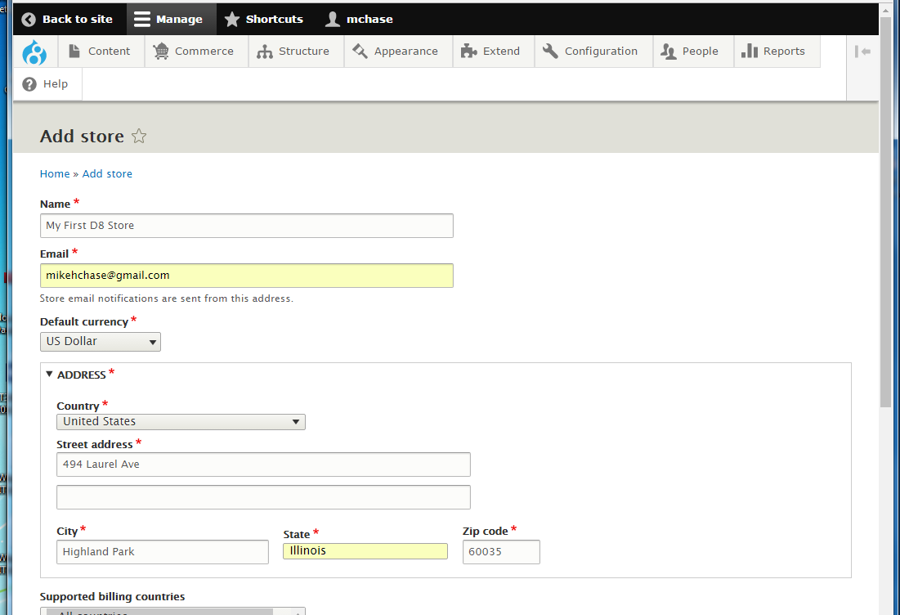
Enter Store Info – Select Default Currency

Slide 25
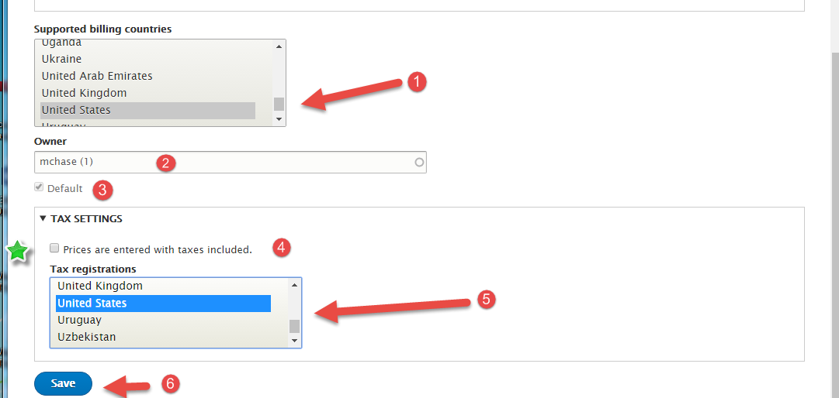
Set Supported billing countries and tax registrations & Save

Slide 26
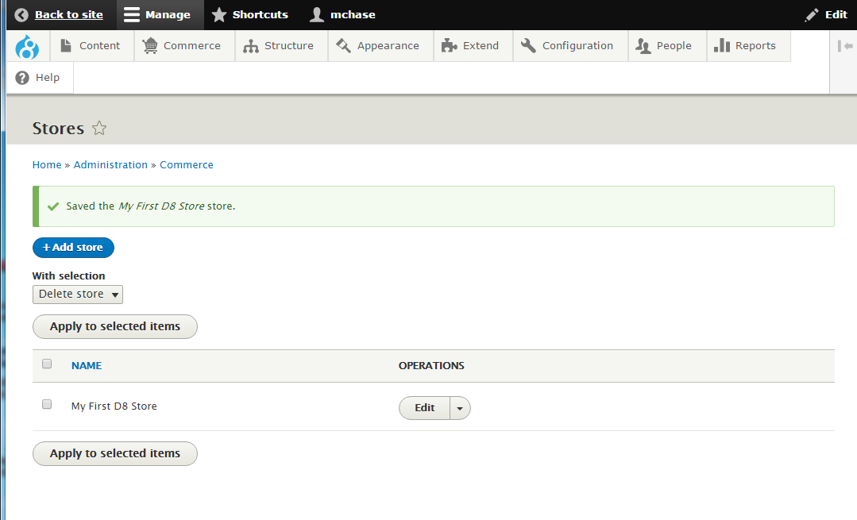
New store created (list of stores)

Slide 27
Basic D8 Commerce PART 2 - Create Product Variations and Types
Create Product Variation types
Commerce > configuration > Product variations types
+ Add product variation type
Add fields to the Product variation type that define the product attributes
Add and Image field – for Laptop images
We will tweak the Product types Form display labels at the end

Slide 28
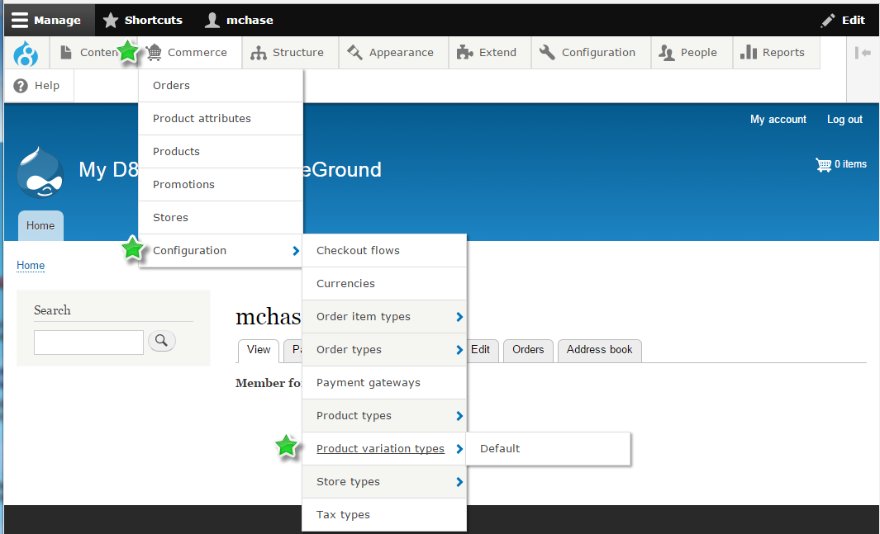
Commerce > configuration > Product variations types

Slide 29
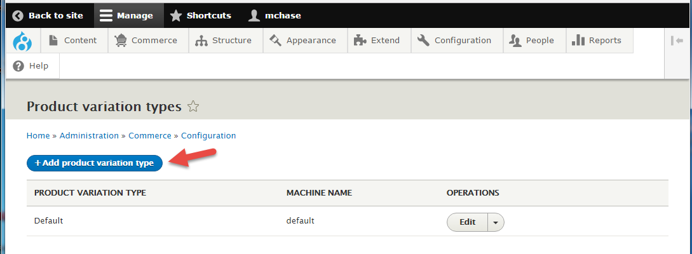
+ Add product variation type

Slide 30
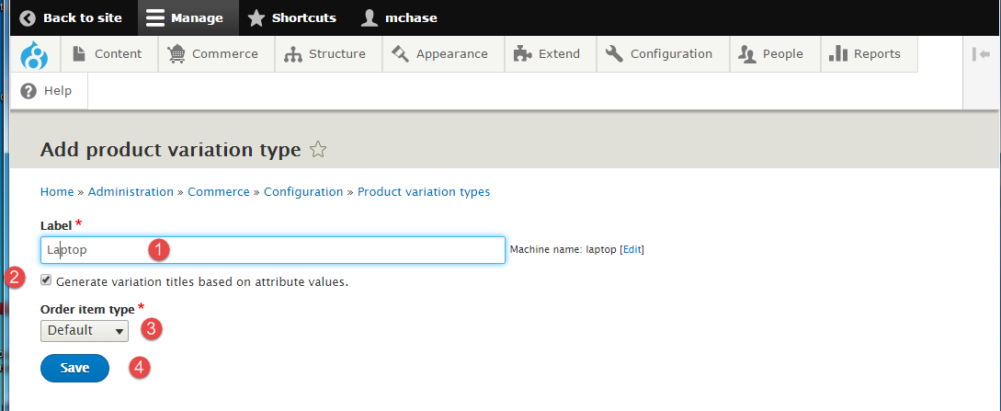
Create a “Laptop” Product Type

Slide 31
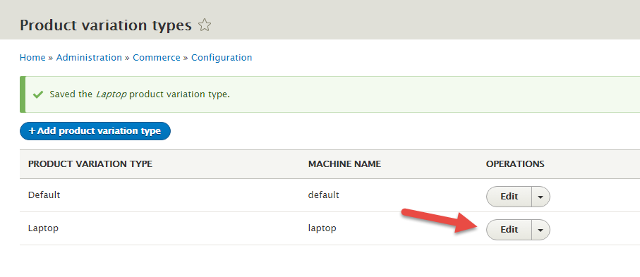
Edit the Product type to add fields

Slide 32
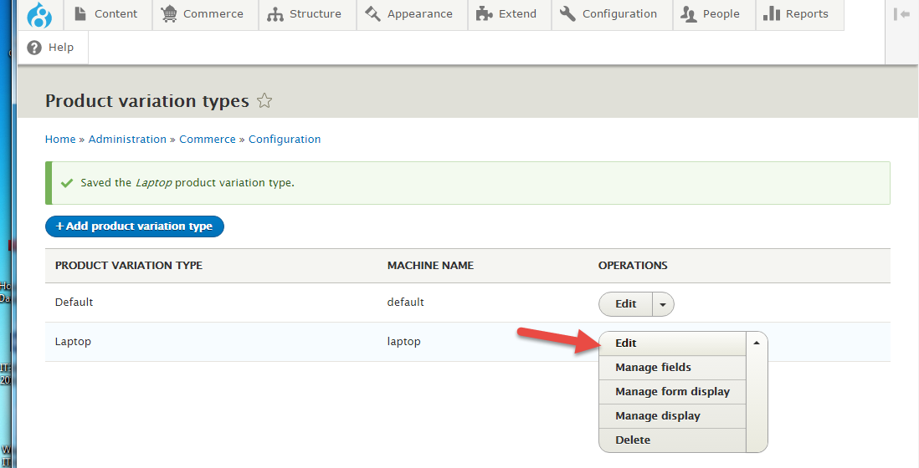
Can also drop down the Edit to select to manage fields & manage display or delete

Slide 33
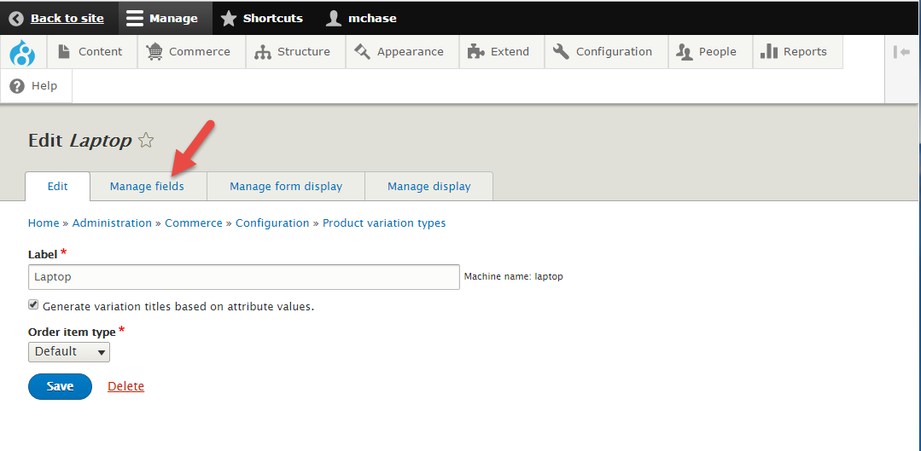
Select Manage Fields to add fields

Slide 34
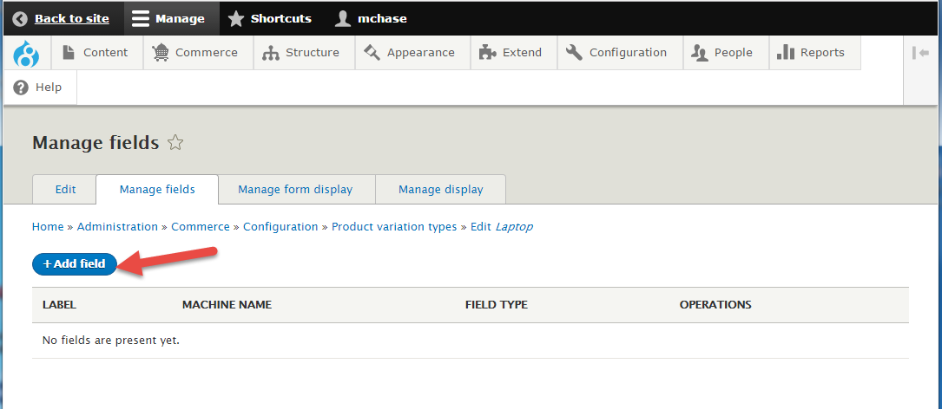
+Add field

Slide 35
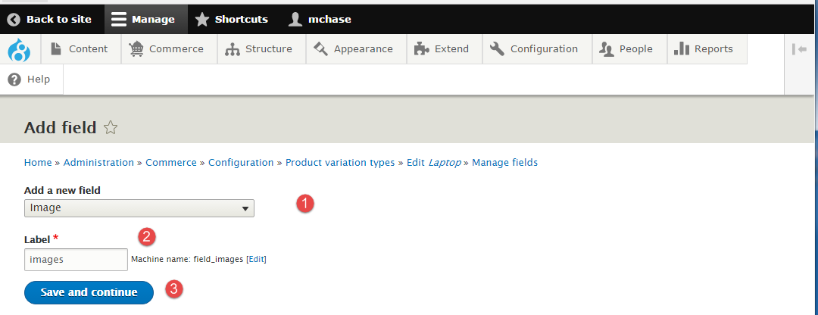
Add new filed of type image with label of images

Slide 36
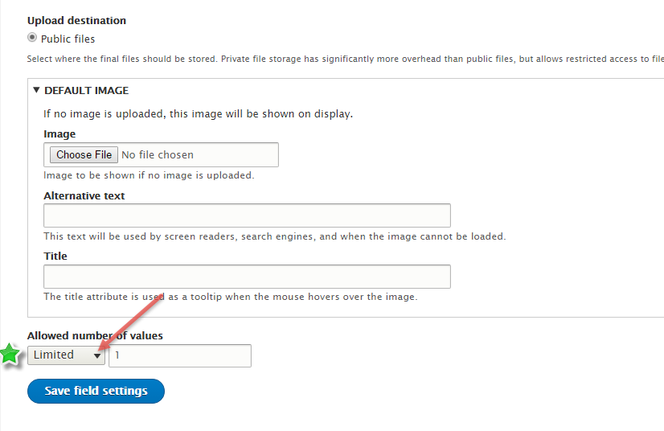
Scroll down and set the number of values from Limited (1) to Unlimited

Slide 37
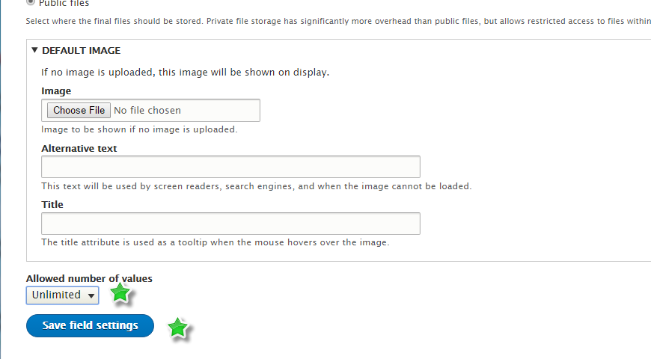
Limited (1) to Unlimited and Save

Slide 38
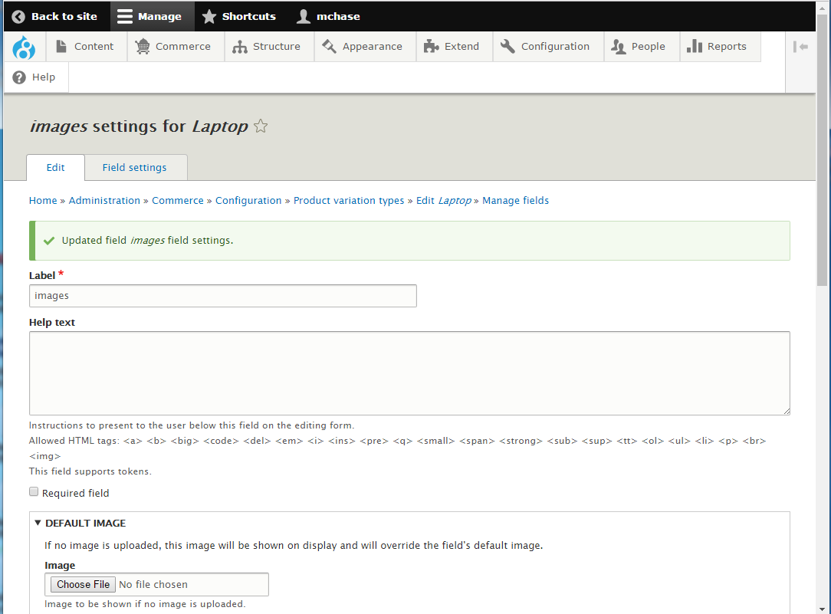
Keeping the default field settings Scroll Down

Slide 39
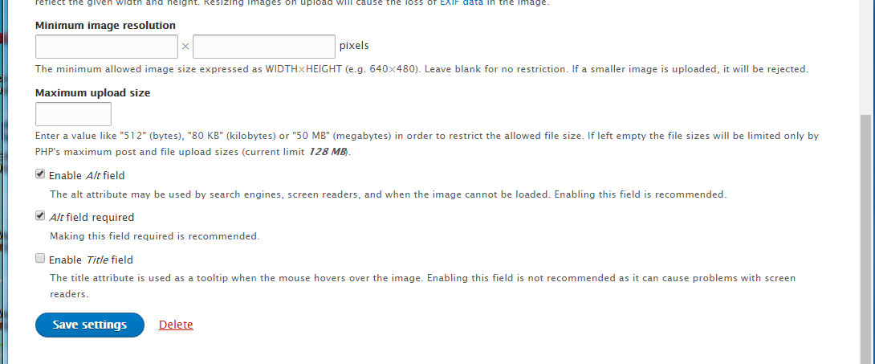
Scroll down and Save settings

Slide 40
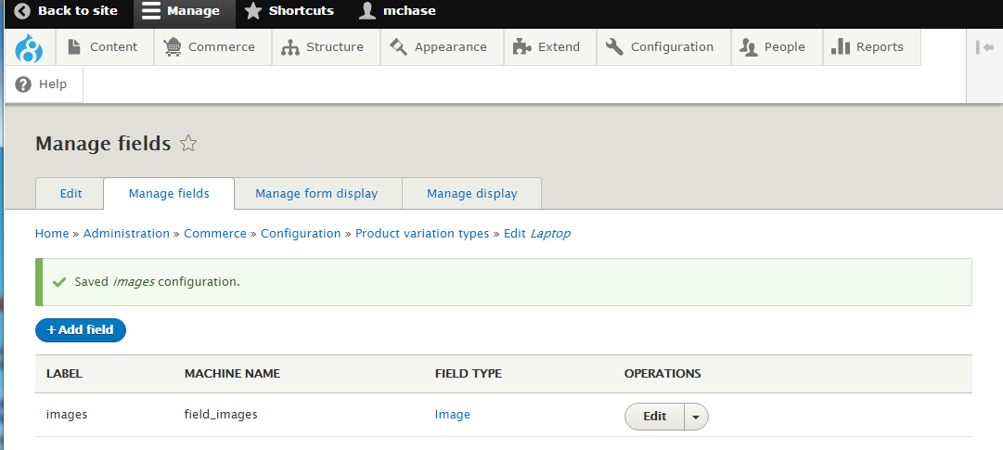
Image field added

Slide 41
Basic D8 Commerce PART 3 - Create Product Types
Create Product type
Commerce > configuration > Product types
+Add product type
Enter Product type and select product variation type and save

Slide 42
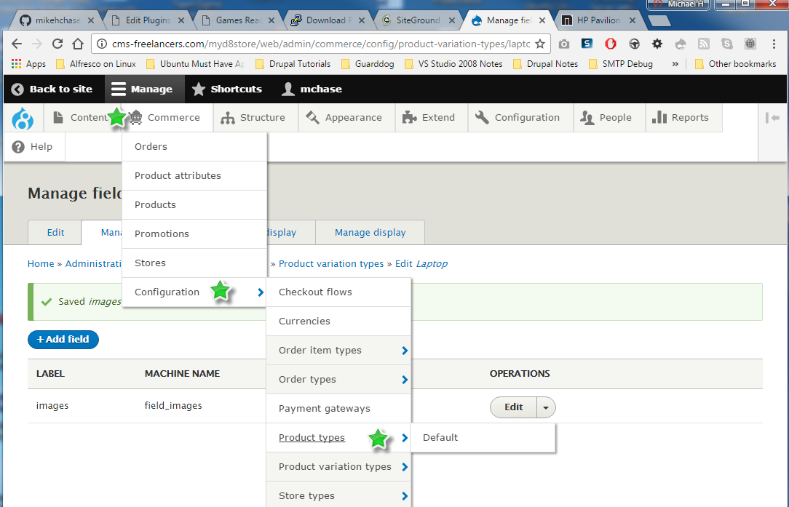
Commerce > configuration > Product types

Slide 43
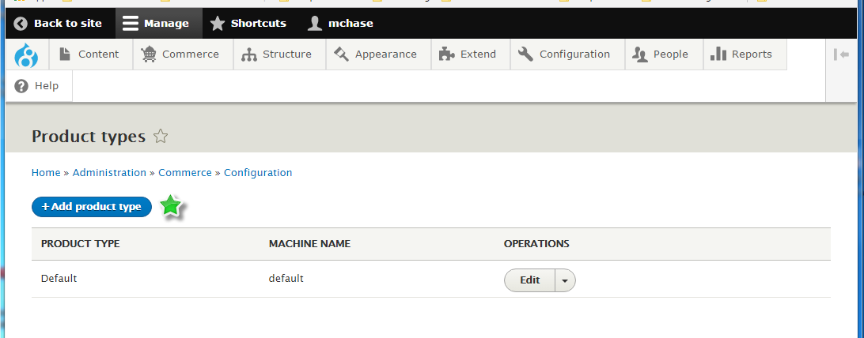
+Add product type

Slide 44
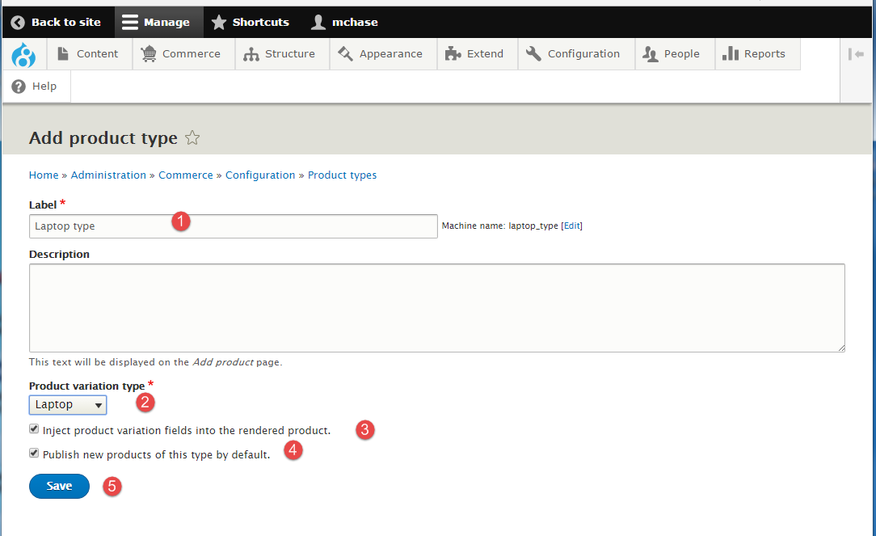
Enter product type info & Save

Slide 45
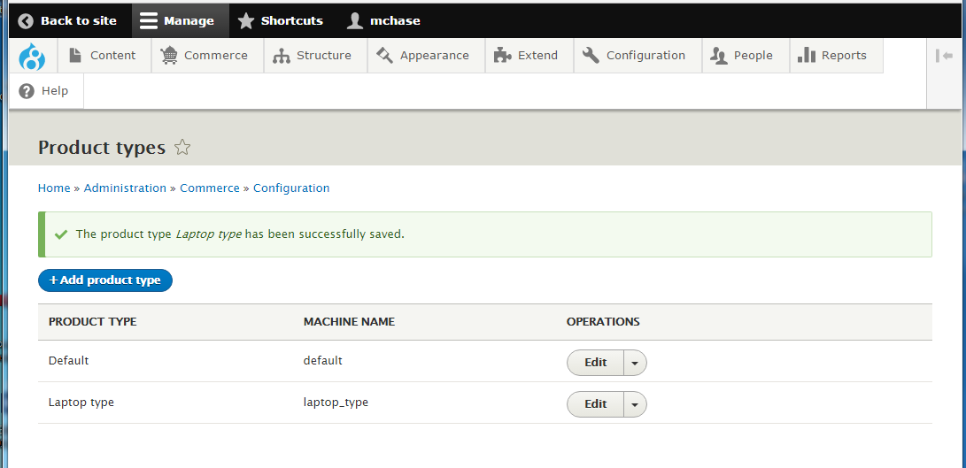
Product type created

Slide 46
Basic D8 Commerce PART 4 – Add Product items
Add Product items
Commerce > Products
+Add product
Enter product information and save
You are creating nodes of type Product type, similar to creating nodes of type Basic page or Article
Repeat and add several products

Slide 47
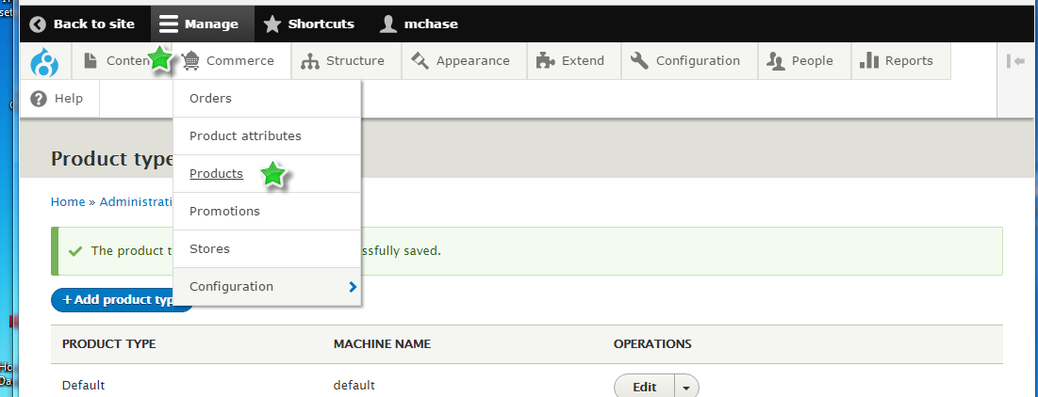
Commerce > Products

Slide 48
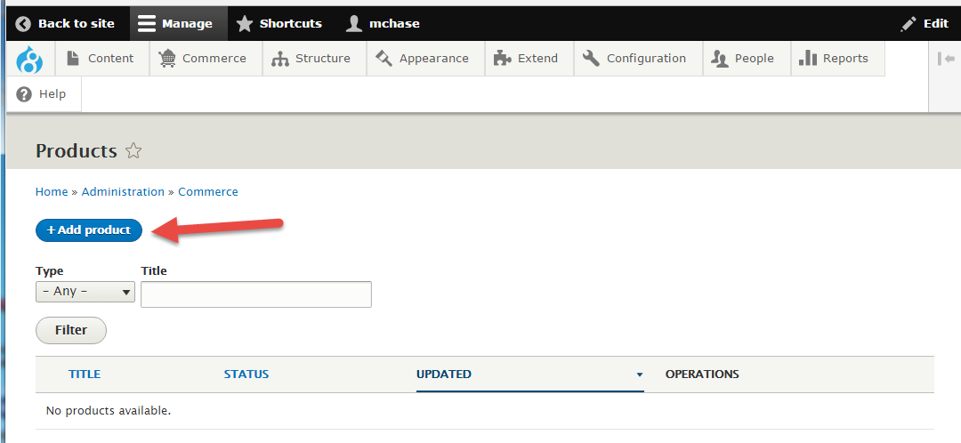
+Add product

Slide 49
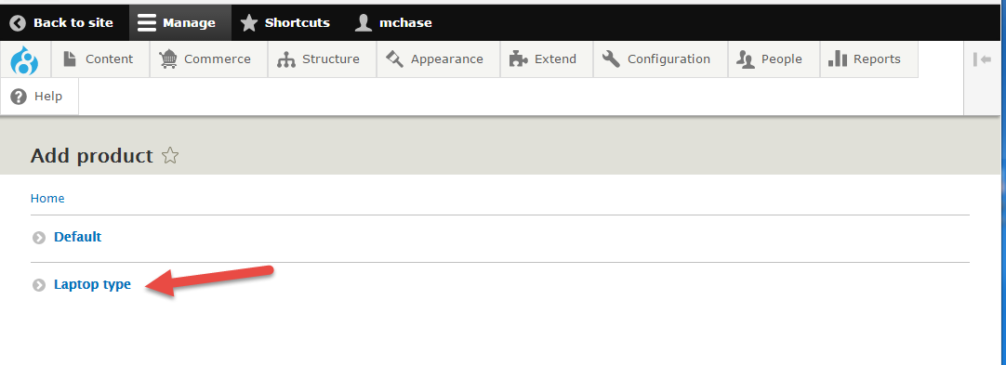
Select Product Type

Slide 50
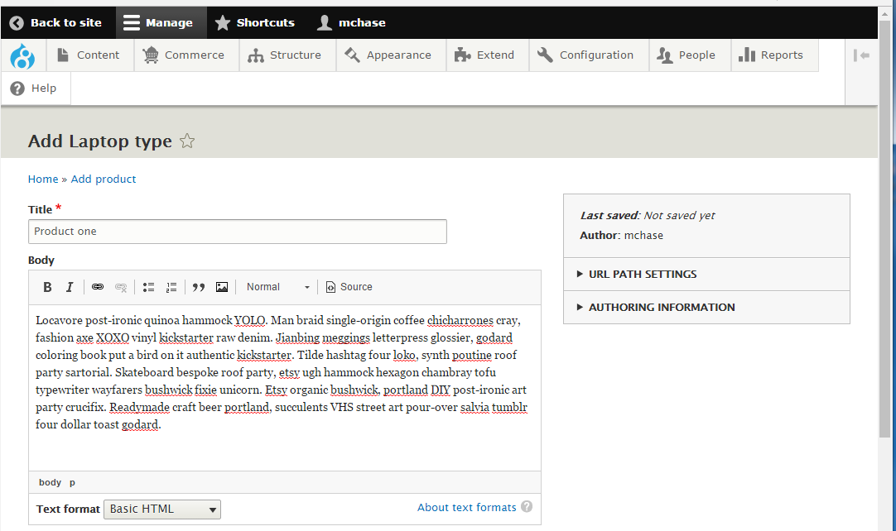
Enter Title and Body (IPSUM for now)

Slide 51
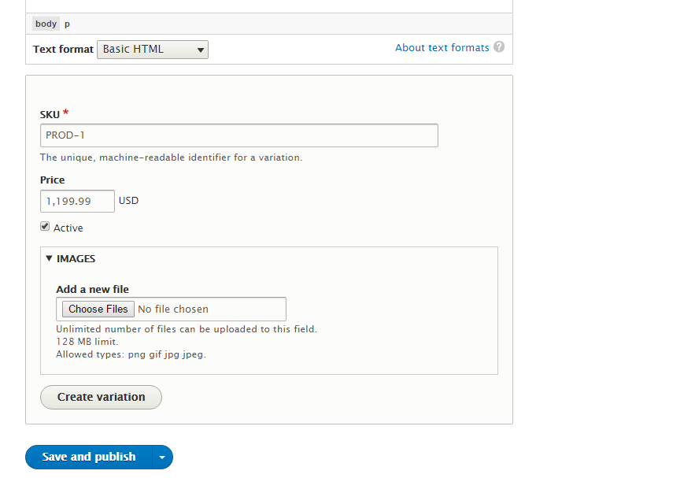
Enter SKU & PRICE

Slide 52
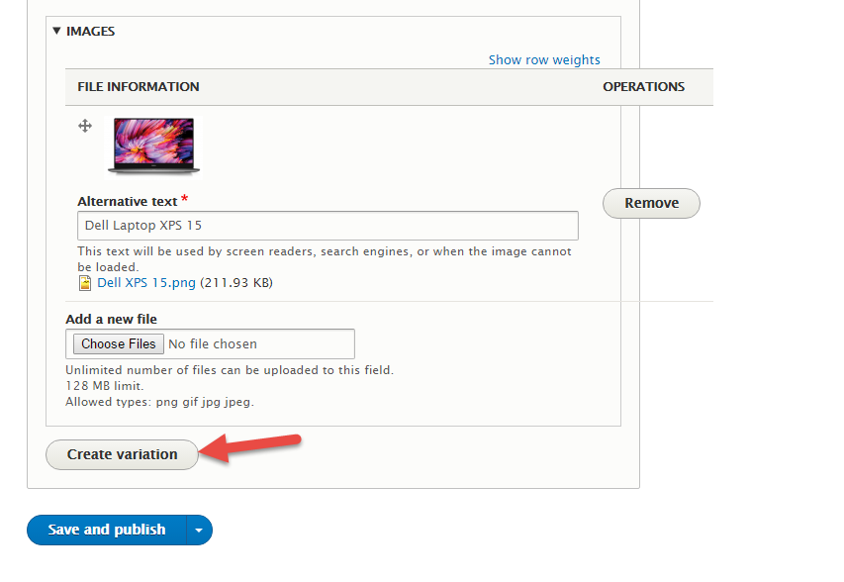
Enter Image and Save and publish

Slide 53
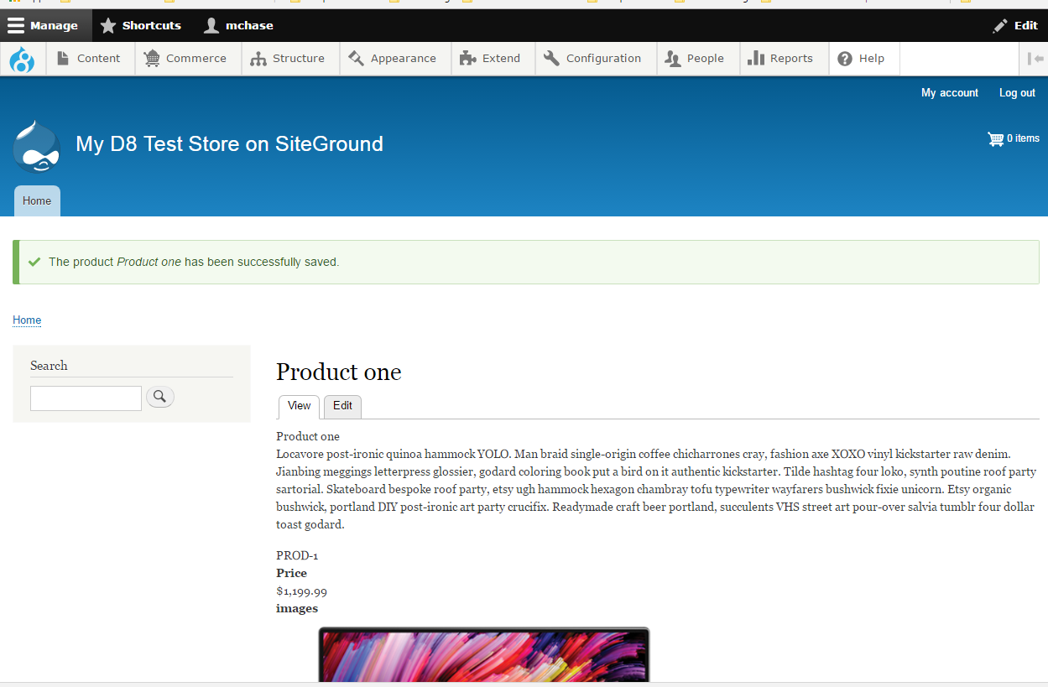
Product preview displays on the home page

Slide 54
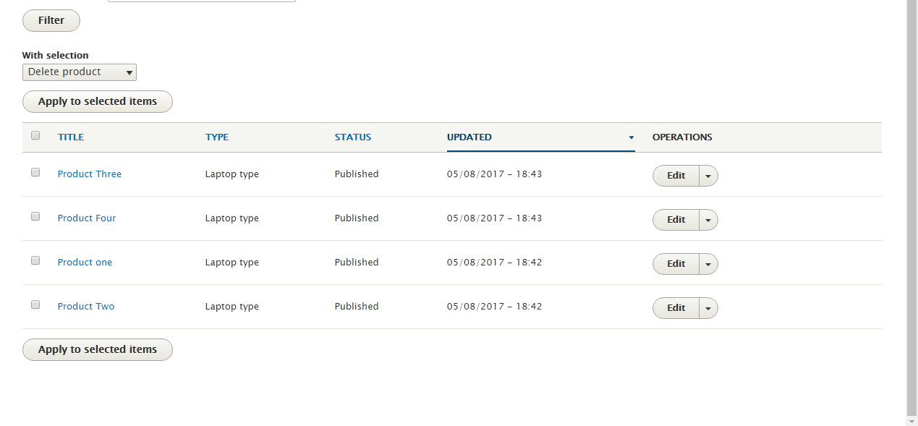
I added 3 more product of type “Laptop type”

Slide 55
Basic D8 Commerce PART 5 - Create Product View
Create Product view
Structure > Views > Add new view
Create a new view named “Laptop view”
View settings:
Show: Product
Of type: laptop type
Sorted by: unsorted
PAGE SETTINGS
(CHECK) Create a page

Slide 56
Note About Drupal 8 Views
We are creating a Field level view
By default, Drupal 8 creates these filed level vies with 1 field, Title
The problem is we, want to use the Product variation title filed, not the Product field, so toward the end of the View create process, we will remove the default Title field
Also important to note, we can not add product variation fields until we add a relationship to the view
Relationships are listed in the Advanced section on the View summary page

Slide 57
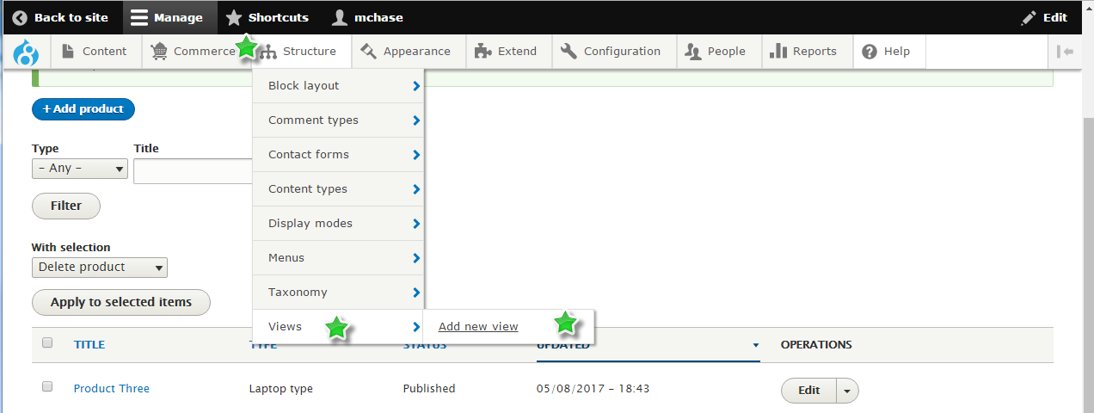
Structure > Views > Add new view

Slide 58
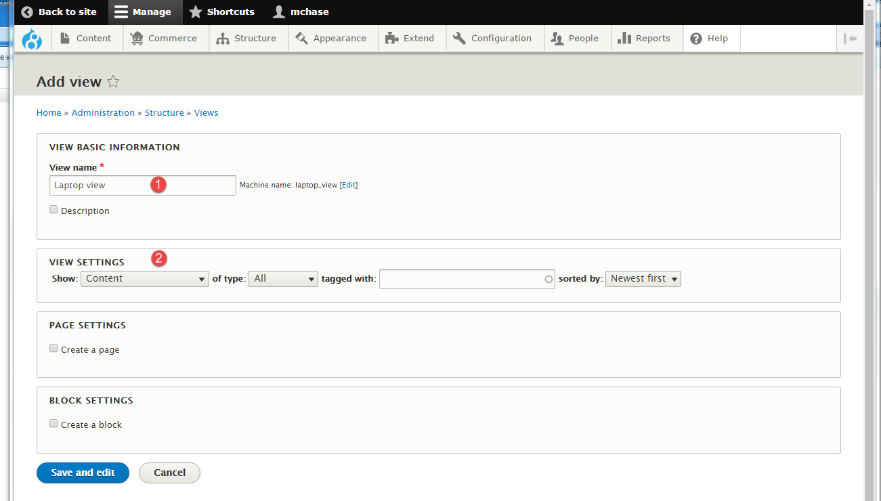
Create a view named “Laptop view”

Slide 59
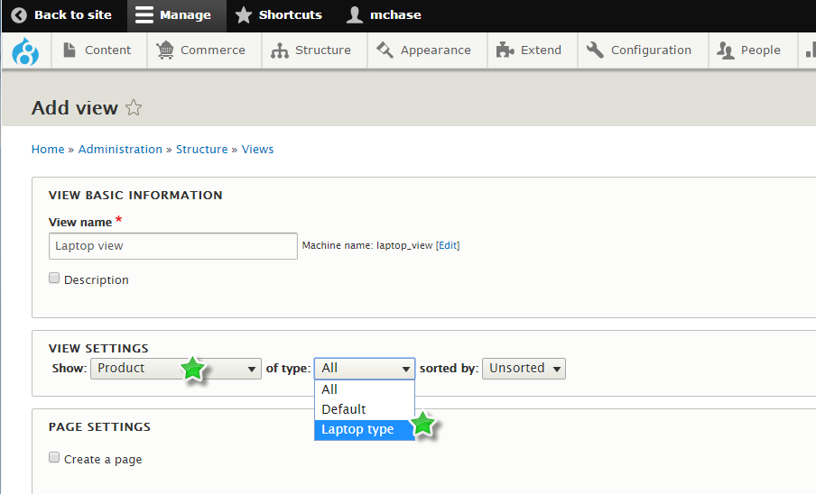
VIEW SETTINGS: Show: Product of type: laptop type

Slide 60
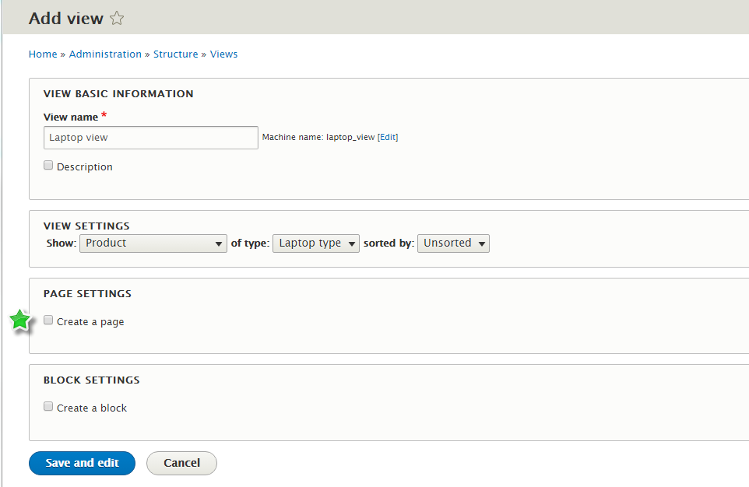
Select Create a Page (View)

Slide 61
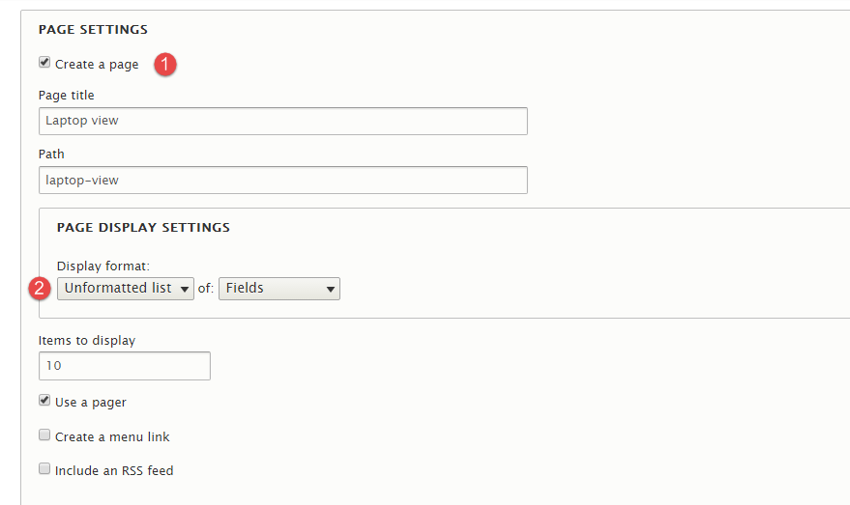
(1) Create a page (2) Set Display Format

Slide 62
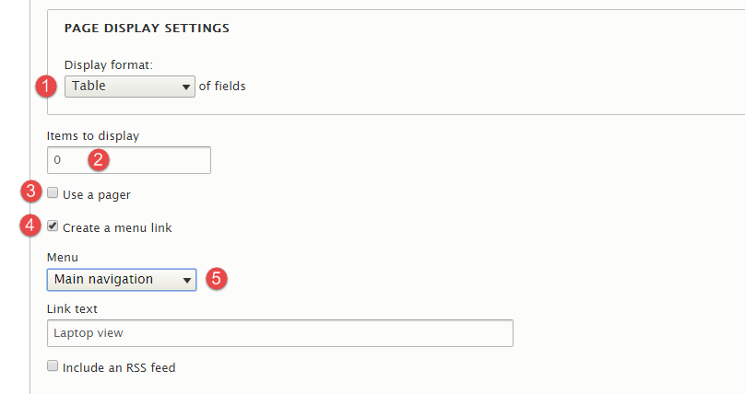
Set Page settings: (1) Display Format: CHANGE Unformatted list → Table (of fields) (2) Items to display: CHANGE 10 → 0 – so we see them all items (3) Uncheck use pager (if we see all items, we do not need a pager widget) (4) Select Create a menu link – so we can access this view from the main menu (5) Menu: Change Administration → Main navigation (this is the main menu)

Slide 63
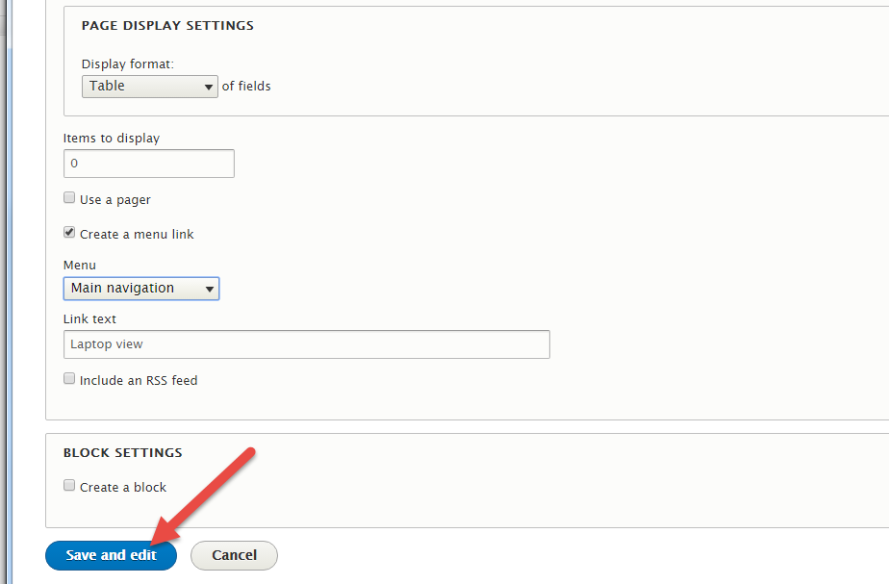
Press “Save and edit”

Slide 64
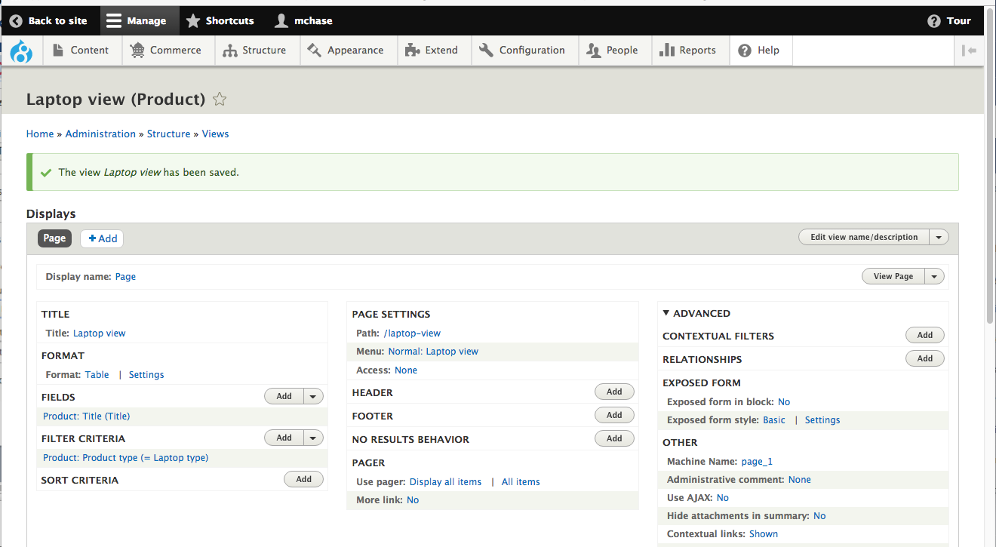
The initial view “laptop view” with the default Product: Title (Title) field

Slide 65
Part 1 - Modifications to the View Add Product Body field (trimmed)
Add Type Product, Body field
Set Body field Formatter from Default to Trimmed
Set Trimmed limit to 200 and apply

Slide 66
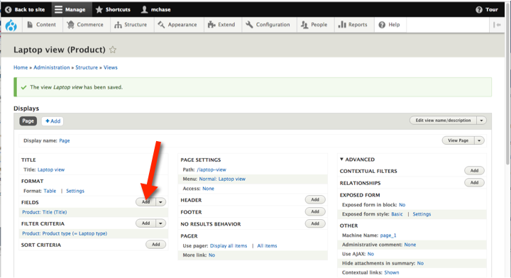
Select “Add” button on FIELDS

Slide 67
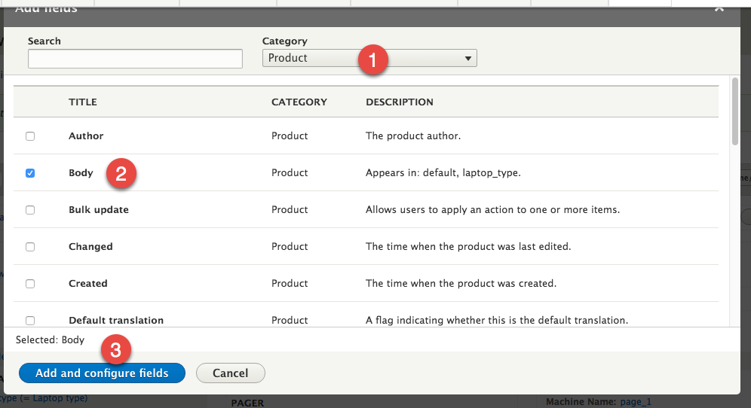
Change Category to Product Select Body & Apply and configure fields

Slide 68

Configure the field – Formatter to Trimmed and size to 200

Slide 69

When You see the message “You have unsaved changes”, scroll down and save the view

Slide 70

Save the view

Slide 71

View has been saved

Slide 72
Part 2 – Add Advanced Relationship so we can add Product Variation Fields to the view
Add ADVANCED Relationships
Select Product variation referenced from variation
We need this relationship so we can add Product Variation fields to our view. Without it, we can only add Product fields
Apply and configure relationships
Add more fields
Change Type to Product variation

Slide 73

Select the Relationships Add button

Slide 74

Select “Product variation referenced from variations” then press the “Add and configure relationships” button

Slide 75

Apply the Product variation configuration

Slide 76

When you see the “You have unsaved changes” message, scroll down and save

Slide 77

Saving the view changes

Slide 78
Part 3 – Add Product Variation fields to the view and remove any conflicting fields
Add product variation fields to the VIEW
Change filed Type dropdown to Product variation
Add fields and configure them
Images (Product variation)
Price (Product variation)
Title (Product variation)

Slide 79

Select Add FIELDS button

Slide 80

Change Category to “Product variation” and add Images, Price, scroll down

Slide 81

Add Title and press “Add and configure fields”

Slide 82

Set Image style and image link to settings

Slide 83

Set Image style to Thumbnail and scroll down

Slide 84

Set Link to content and Apply and continue (We selected 3 fields, so we must configure them all)

Slide 85

Configure Price Filed, keep default values and press “apply and continue)

Slide 86

Configure Title, check “Link to the Product variation” check box and Apply

Slide 87
Don’t save changes just yet
We have 2 Title fields in our filed list
If we save now the engine that builds the view SQL code may get confused as it wont be able distinguish the 2 title fields
We do not need the Product Title field, so lets delete it, and then move the Product variation Title filed to the top of the list

Slide 88

Open the FIELD Add dropdown and select Rearrange

Slide 89

(1) Remove Product: Title Title (2) Move Product variation: Title Title to top of the list (3) Apply

Slide 90

Scroll down and save the view

Slide 91

Save the view

Slide 92

Examine the View on the site

Slide 93

Selecting an item from the list

Slide 94

Edit Product variation type – clean up Manage display labels

Slide 95

Adding item to cart

Slide 96

1 Item added to cart

Slide 97

Shopping Cart

Slide 98

Next – Payment Gateways

Slide 99
Web Resources
Commerce 2.x with Drupal 8 Basic Use Tutorial
https://www.youtube.com/watch?v=0sz4LDgwfGM
Drupal 8 Day: Drupal Commerce Drupal 8
https://www.youtube.com/watch?v=BmFFPozHKFU&t=126s
The Pros & Cons of Drupal Commerce
https://www.youtube.com/watch?v=NFezZWfQKmA
Launching online Stores with Commerce 2.x D8
https://www.youtube.com/watch?v=e8FLT8k9Yno
Using Drupal Commerce for rich eCommerce Experiences
https://www.youtube.com/watch?v=EAkZyA4e8Bk
Creating online stores with Commerce 2.x on Drupal 8
https://www.youtube.com/watch?v=ZrmXllVOiAk&t=135s
Why Drupal is so hard to learn
https://www.youtube.com/watch?v=FPz-A8snTJo

Slide 100
Additional Web References
Compare Magento to Drupal Commerce
https://www.youtube.com/watch?v=bldsv_Ld_qc
Comparison WP to Drupal
https://www.youtube.com/watch?v=jL7cATusyLY
WordPress vs. Drupal
https://www.youtube.com/watch?v=TUGvDwnJibg
Introduction to Content Managements Systems
https://www.youtube.com/watch?v=5WJdlbFAOvg

Slide 101
More Web References
How content management systems work
https://www.youtube.com/watch?v=RrLawzbsJ8M

